Slide 1
Adopting Angular2 as an accelerator for new UI development – an LDNG journey
Vishnu Palaniswamy
Dan Liu

Slide 2
Agenda
Problem statement – why did we need to start looking for a new UI development framework?
Technology selection process – how and why did we pick Angular2?
Angular2 adoption – how did we incorporate Angular2 into our application and our development processes?
Takeaways and benefits – how did using Angular2 help our project timelines and our staff development?
Questions and Some Answers?

Slide 3
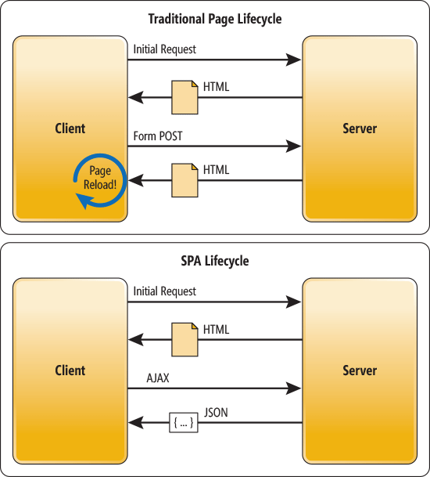
LDNG UI is a JavaScript Single Page Application (Do we need this slide?)

Slide 4
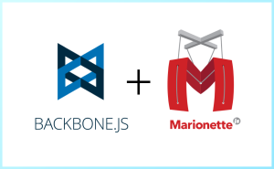
About the New Loan Delivery (LDNG) Web Application
LDNG Application
UI is used by 2000 lenders, ranging from small to large.
Many lenders use the UI exclusively to add loans and deliver
39* total screens and modal windows
52K lines of JavaScript code
8 JavaScript developers worked on it from April 2014 through October 2015
Single Page Application built with Backbone JS and Marionette JS
Backbone JS is a library, not a framework
Provides Model, Collection and View
Marionette JS adds framework like features, reduces boiler-plate code
No two way binding or declarative forms support
App uses many other open-source 3rd party libraries and tools
* inclusive of various roles and views
Notes:
When we say LDNG application, we are really taking about the UI application. There is no B2B or API. Lenders use app to import loans, clear their edits and submit them.
Talk about 1150 users using Data entry. UI app. Edit processing. Small and large volumes.
Quicken vs mom and pop (credit unions).
Relative measure – 43K of UI backend code

Slide 5
Why was there a pressing need for technology change?
Program and Personnel Challenges
Due to program delivery commitments, LDNG had significant hiring needs (21 developers were hired in 2016)
Developers with Backbone JS experience became increasingly scarce in the market
Backbone JS itself had decreased in community activity and enterprise adoption overall
Out of 120+ candidates screened, less than 5 had Backbone JS listed on their resumes
Technology Challenges
Steep learning curve for existing developers, especially those coming from a Java background
Needed a sustainable platform for the future
The new Loan Certification program was to start soon

Slide 6
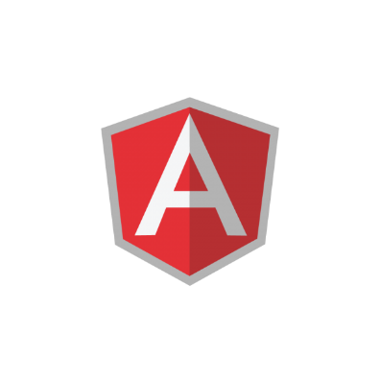
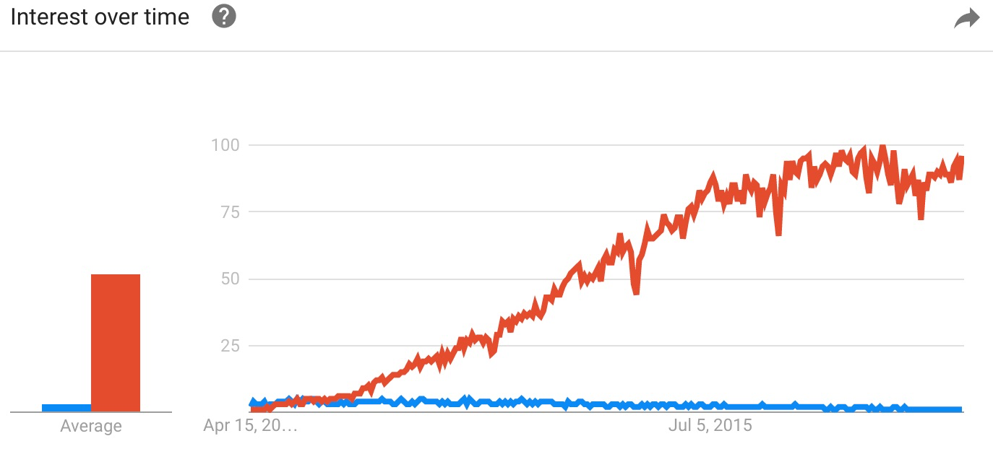
Why Angular? (Angular 2)
Framework | Language | Ecosystem
A “full” framework Moves more responsibility from the developer into the framework Two-way binding with change detection is a big benefit (but, beware!) Angular 2 is substantially different from Angular 1.x and we did not want to start with a ‘legacy’ framework and go through an upgrade later. Convention based and prescribes an application structure and other aspects - Angular Style Guide Angular CLI - Command line tools: create app, add components and tests, build then instantly deploy. | Angular 2 applications are written in TypeScript. In fact, Angular 2 itself is written in TypeScript. TypeScript is object-oriented JavaScript with strong datatypes. It’s easier-to-learn for non-UI/JavaScript developers. Future proof: Typescript code is transpiled to JavaScript during build and can be targeted to ES5/ES6 JavaScript. Stackoverflow’s 2017 global developer survey listed TypeScript as the 3rd most loved language! | Community adoption is skyrocketing - Growing eco-system – Angular Summit is mostly focused on Angular 2 at this point Growing interest for Angular Angular team is committed to release updates every 6 months. Angular 4 was released on schedule, last month.

Slide 7
Execution
Evaluate/Prototype
to assess feasibility of a hybrid Backbone and Angular app
Angular 2 was not GA, but was in the final RC stages. We assessed when we would start
Switched to IntelliJ, which has great Angular support. Visual Studio Code also has Angular support.
Introduce
New Loan Delivery functionality (Baliee and Early Funding) will be developed with Angular 2, with the same Look and Feel
Started with 1 Scrum team and 2 other teams started very next Sprint.
Both new developers and backend developers picked up quickly and contributed.
Angular code is built, tested and deployed with CI/CD. Some days we have 5 builds to dev.
Current State
Loan Certification platform developed with Angular 2
All teams working on Angular

Slide 8
Angular with TDD
Code coverage – 80%
Test Driven Development (TDD)
Better Code Quality
Easy/Safer Refactoring
Living Documentation
Tools and Technologies
Angular testing utilities
- provide test environment for the code under test
Jasmine
- unit test framework for Javascript
Karmar
- test runner
Selenium/Protractor
- write and run end-to-end (e2e) tests

Slide 9
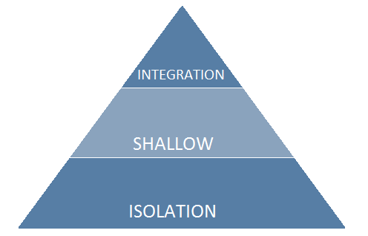
Angular Unit Test Pyramid
Isolation Tests
Test logic only
No DOM, all dependencies mocked, plain old JavaScript objects
ex: math, transforms
Shallow Tests
Test at individual component level
Test local interactions without other component dependency
ex: event wiring, display logic
Integration Tests
Test interactions among components
multiple components are rendered
ex: routing, data communication, component interactions

Slide 10
Metrics comparison of development time/effort/complexity – and richness of features
Notes:
- Developers new to UI / JavaScript development and backend developers picked up Angular 2

Slide 11
Program benefits

Slide 12
Demo
Notes:
- What should we show?

Slide 13
Questions and hopefully we have some answers!

Slide 14
Resources
Official Website - https://angular.io/
Angular 2 Style Guide - https://angular.io/styleguide
Safari Bookshelf
Angular 2 Development with TypeScript
Switching to Angular 2
Angular 2 Deep Dive
Udemy/YouTube videos

